Slide 1
CSE 12 Week 4 Discussion
4-23-21
Focus: PA4, Counting Step & Runtime Analysis

Slide 2
Reminders
PA4 is an open assignment - collaborate!
PA1 Resubmission due today (Friday, April 23rd 11:59 PM)!
PA2 Resubmission due Friday, April 30th 11:59 PM, and it’s open for collaboration!
PA3 Resubmission due Friday, May 7th 11:59 PM

Slide 3
PA4 Overview
Only 16/70 points are autograded, don’t rely on resubmission for this assignment!
Two Parts
Part 1: Questions
Big-O Justification
Analysis of ArrayStringList and LinkedStringList
6 Mystery Functions: Determe big-Θ, measure implementations (in part 2) and match
Part 2: Code
Write a program to measure the mystery methods
Matches the methods to the source given
Generate graphs to justify

Slide 4
How to measure runtime in Java
Remember to do two things to ensure your measurements are as accurate as possible:
Turn off Java compiler optimizations
Call each method once (dummy call) before calling them to measure their runtimes; the timing of the first call can be noisy and inaccurate
How to turn off optimization in Eclipse (from the write up; scroll to last page):
https://docs.google.com/document/d/1vwckO76TrBT8B5E4xQ2-v2OXncLa6SQWuaQkNZaCPB0/edit
How to turn off optimization in terminal
add in the flag in your javac and java commands. Examples: java -Djava.compiler=NONE myClass
Example code from discussion on how to calculate runtime of a method using System.nanoTime() will be posted on the course Github

Slide 5
Counting Steps...
100
50
25
10
How many times does the following loop run?
for (int i = 1; i < 1000; i*=2) {
System.out.println(i);
}

Slide 6
Answer - D
Loop index increments by a factor of 2 each iteration:
i = 1...2...4...8...16...32...64...128...256...512 (10 times total)
And fails to run when i = 1024 since i > 1000

Slide 7
Counting Steps...
We have a Linked List containing 10 nodes (including the dummy node). If we are searching for “Jerry” using find() but the Linked List does not contain “Jerry”, how many times will the while loop condition execute?
9
1
3
10
//LINKED LIST THAT HOLDS A STRING IN EACH NODE
boolean find(String toFind) {
Node current = this.front.next;
while(current != null) {
if(current.value.equals(toFind)) {return true;}
current = current.next;
}
return false;
}

Slide 8
Answer - D
Considering the LinkedList has 10 nodes, we will loop through all Nodes until a match is found.
There will be no match in this case since “Jerry” is not in the LinkedList.
We will therefore go through the loop condition 10 times.
//LINKED LIST THAT HOLDS A STRING IN EACH NODE
boolean find(String toFind) {
Node current = this.front.next;
while(current != null) {
if(current.value.equals(toFind)) {return true;}
current = current.next;
}
return false;
}

Slide 9
Loop Iterations vs Linked List Length
(when String to find is not in list)
Loop Iterations
Linked List Length

Slide 10
Counting Steps...
If we are still searching for “Jerry” and it is found in the LinkedList, how many times will the while loop run?
9
1
10
Cannot be determined
//LINKED LIST THAT HOLDS A STRING IN EACH NODE
boolean find(String toFind) {
Node current = this.front.next;
while(current != null) {
if(current.value.equals(toFind)) {return true;}
current = current.next;
}
return false;
}

Slide 11
Answer - D
If “Jerry” is in the LinkedList, we do not know exactly how many Nodes from the start it is located.
It could be located at start of list, end, middle, anywhere...
//LINKED LIST THAT HOLDS A STRING IN EACH NODE
boolean find(String toFind) {
Node current = this.front.next;
while(current != null) {
if(current.value.equals(toFind)) {return true;}
current = current.next;
}
return false;
}

Slide 12
Counting Steps...
//FIND FIRST MATCHING VALUE ACROSS BOTH LISTS
String findMatch(LinkedList a, LinkedList b) {
Node aNode = a.first.next;
for (int i = 0; i < a.size; i++) {
Node bNode = b.first.next;
for (int j = 0; j < b.size; j++) {
if (aNode.value.equals(bNode.value) {
return aNode.value;
}
bNode = bNode.next;
}
aNode = aNode.next;
}
return null;
}
Assuming that there are no matches between the two Linked Lists a and b, how many times would the inner if statement be executed?
a.size
b.size
a.size * b.size
a.size + b.size
None of the above

Slide 13
Answer - C
//FIND FIRST MATCHING VALUE ACROSS BOTH LISTS
String findMatch(LinkedList a, LinkedList b) {
Node aNode = a.first.next;
for (int i = 0; i < a.size; i++) {
Node bNode = b.first.next;
for (int j = 0; j < b.size; j++) {
if (aNode.value.equals(bNode.value) {
return aNode.value;
}
bNode = bNode.next;
}
aNode = aNode.next;
}
return null;
}
The inner if statement is inside both for loops.
Outer for loop runs a.size times.
Inner for loop runs b.size times.
Anything inside inner for loop is called a.size * b.size times.

Slide 14
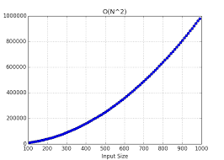
If Statement Calls vs List Sizes (when no items match across two lists)

Slide 15
Categorizing Runtimes

Slide 16
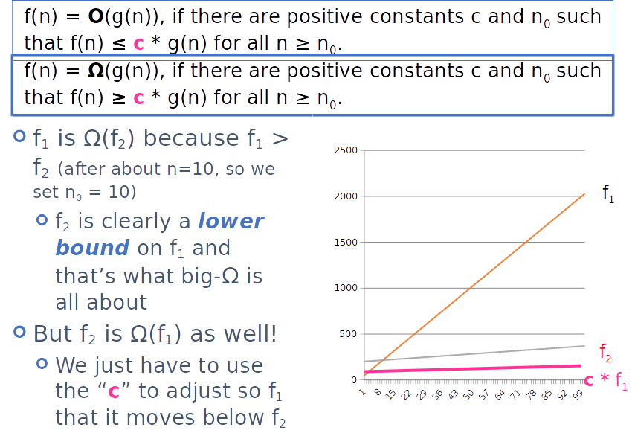

Slide 17
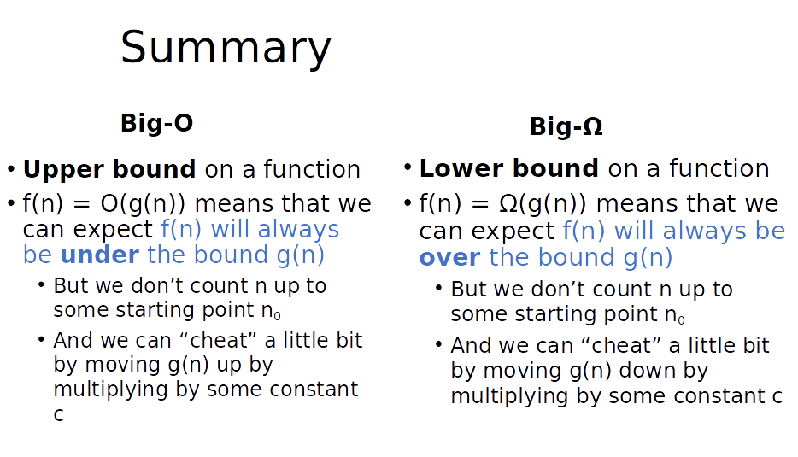

Slide 18
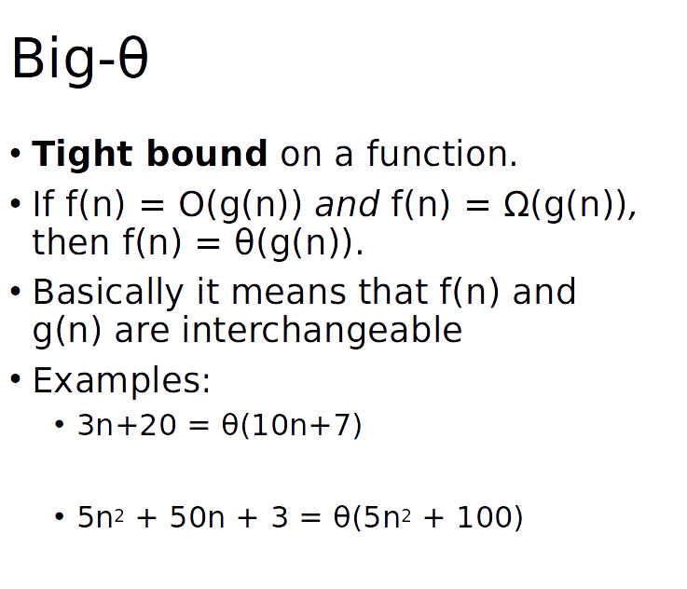
Usually in a coding interview, when the interviewer asks you “the big-O bound” of an algorithm, they are referring to the tight bound

Slide 19
Let f(n) = 100
Which of the following is true?
f(n) is O(2^{n})
f(n) is O(n²)
f(n) is O(n)
All of these
None of these

Slide 20
Let f(n) = 100
Which of the following is true?
f(n) is O(2^{n})
f(n) is O(n²)
f(n) is O(n)
All of these
None of these
What about the tight bound?

Slide 21
public static void printSomething(int[] items) {
System.out.println(items[0]);
int middleIndex = items.length / 2;
int index = 0;
while (index < middleIndex) {
System.out.println(items[index]);
index++;
}
for (int i = 0; i < 100; i++) {
System.out.println("hi");
}
}
What is the tight bound of printSomething(), if the length of items is n?
Θ (logn)
Θ (n)
Θ (1)
None of the above

Slide 22
public static void printSomething(int[] items) {
System.out.println(items[0]);
int middleIndex = items.length / 2;
int index = 0;
while (index < middleIndex) {
System.out.println(items[index]);
index++;
}
for (int i = 0; i < 100; i++) {
System.out.println("hi");
}
}
What is the tight bound of printSomething(), if the length of items is n?
Θ (logn)
Θ (n)
Θ (1)
None of the above
Θ(n)
Θ (1)

Slide 23
public int binarySearchItem(int[] sortedArray, int value) {
int index = -1;
int low = 0;
int high = sortedArray.length;
while (low <= high) {
int mid = (low + high) / 2;
if (sortedArray[mid] < value) {
low = mid + 1;
} else if (sortedArray[mid] > value) {
high = mid - 1;
} else if (sortedArray[mid] == value) {
index = mid;
break;
}
}
return index;
}
We are using this algorithm to search in a sorted array of integers for the index of an integer value. What is the tight bound for this algorithm?
Θ (logn)
Θ (n)
Θ (1)
None of the above

Slide 24
public int binarySearchItem(int[] sortedArray, int value) {
int index = -1;
int low = 0;
int high = sortedArray.length;
while (low <= high) {
int mid = (low + high) / 2;
if (sortedArray[mid] < value) {
low = mid + 1;
} else if (sortedArray[mid] > value) {
high = mid - 1;
} else if (sortedArray[mid] == value) {
index = mid;
break;
}
}
return index;
}
We are using this algorithm to search in a sorted array of integers for the index of an integer value. What is the tight bound for this algorithm?
Θ (logn)
Θ (n)
Θ (1)
None of the above

Slide 25
Assume that we want to look for the integer 2 in the following array:
public int binarySearchItem(int[] sortedArray,
int value) {
int index = -1;
int low = 0;
int high = sortedArray.length;
while (low <= high) {
int mid = (low + high) / 2;
if (sortedArray[mid] < value) {
low = mid + 1;
} else if (sortedArray[mid] > value) {
high = mid - 1;
} else if (sortedArray[mid] == value) {
index = mid;
break;
}
}
return index;
}
low
mid
high
1
2
3
4
Index: 0 1 2 3 4

Slide 26
Assume that we want to look for the integer 2 in the following array:
public int binarySearchItem(int[] sortedArray,
int value) {
int index = -1;
int low = 0;
int high = sortedArray.length;
while (low <= high) {
int mid = (low + high) / 2;
if (sortedArray[mid] < value) {
low = mid + 1;
} else if (sortedArray[mid] > value) {
high = mid - 1;
} else if (sortedArray[mid] == value) {
index = mid;
break;
}
}
return index;
}
high
low
mid
1
2
3
4
Index: 0 1 2 3 4

Slide 27
Assume that we want to look for the integer 2 in the following array:
public int binarySearchItem(int[] sortedArray,
int value) {
int index = -1;
int low = 0;
int high = sortedArray.length;
while (low <= high) {
int mid = (low + high) / 2;
if (sortedArray[mid] < value) {
low = mid + 1;
} else if (sortedArray[mid] > value) {
high = mid - 1;
} else if (sortedArray[mid] == value) {
index = mid;
break;
}
}
return index;
}
high
mid
low
1
2
3
4
Index: 0 1 2 3 4

Slide 28
Assume that we want to look for the integer 2 in the following array:
public int binarySearchItem(int[] sortedArray,
int value) {
int index = -1;
int low = 0;
int high = sortedArray.length;
while (low <= high) {
int mid = (low + high) / 2;
if (sortedArray[mid] < value) {
low = mid + 1;
} else if (sortedArray[mid] > value) {
high = mid - 1;
} else if (sortedArray[mid] == value) {
index = mid;
break;
}
}
return index;
}
high
mid
low
1
2
3
4
Index: 0 1 2 3 4

Slide 29
Assume that we want to look for the integer 2 in the following array:
public int binarySearchItem(int[] sortedArray,
int value) {
int index = -1;
int low = 0;
int high = sortedArray.length;
while (low <= high) {
int mid = (low + high) / 2;
if (sortedArray[mid] < value) {
low = mid + 1;
} else if (sortedArray[mid] > value) {
high = mid - 1;
} else if (sortedArray[mid] == value) {
index = mid;
break;
}
}
return index;
}
high
mid
low
1
2
3
4
Index: 0 1 2 3 4

Slide 30
Assume that we want to look for the integer 2 in the following array:
public int binarySearchItem(int[] sortedArray,
int value) {
int index = -1;
int low = 0;
int high = sortedArray.length;
while (low <= high) {
int mid = (low + high) / 2;
if (sortedArray[mid] < value) {
low = mid + 1;
} else if (sortedArray[mid] > value) {
high = mid - 1;
} else if (sortedArray[mid] == value) {
index = mid;
break;
}
}
return index;
}
high
mid
low
1
2
3
4
Index: 0 1 2 3 4

Slide 31
Assume that we want to look for the integer 2 in the following array:
public int binarySearchItem(int[] sortedArray,
int value) {
int index = -1;
int low = 0;
int high = sortedArray.length;
while (low <= high) {
int mid = (low + high) / 2;
if (sortedArray[mid] < value) {
low = mid + 1;
} else if (sortedArray[mid] > value) {
high = mid - 1;
} else if (sortedArray[mid] == value) {
index = mid;
break;
}
}
return index;
}
high
mid
low
1
2
3
4
Index: 0 1 2 3 4
Integer found!

Slide 32
Questions?
Feel free to bring up other runtime problems you are confused about!

Slide 33
Poll: Next Topic
Midterm 1 Review Q & A
Past Quizzes Q & A

